Slide 1

Practical steps for creating meaningful scientific figures
Scientific figures seminar – Part 2
Jérôme Hilaire & William Lamb
29 November 2018

Slide 2
Figure creation workflow
(Almost) as easy as 1 2 3…

Slide 3
Workflow 1: Keep the goals in mind
“Remember, in science, message and readability of the figure is the most important aspect while beauty is only an option”
Rougier et al. (2014)
“Ten Simple Rules for Better Figures”

Slide 4

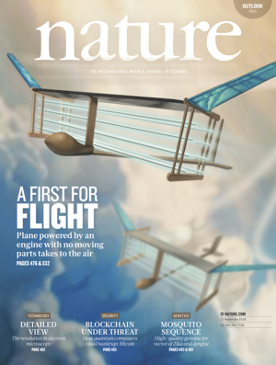
Workflow 2: Know your target
OR
“Figures should be in a finished
form suitable for publication. […]“

Slide 5


Workflow 3: Figures as an iterative process
Create

Slide 6

Workflow 3: Figures as an iterative process
Create
Discuss

Slide 7
Workflow 3: Figures as an iterative process
Create
Discuss

Slide 8

Workflow 3: Figures as an iterative process
Create
Enhance
Discuss

Slide 9
Why use Inkscape?
Sharpen your message and enhance readibility more efficiently
Find right figure layout
Annotate, add guiding lines …
Combine and scale figures
Create high-quality conceptual figures

Slide 10
Inkscape

Slide 11
What is Inkscape?
„Inkscape is professional quality vector graphics software which runs on Linux, Mac OS X and Windows desktop computers.“

Slide 12

What is Inkscape?
„Inkscape is professional quality vector graphics software which runs on Linux, Mac OS X and Windows desktop computers.“

Slide 13
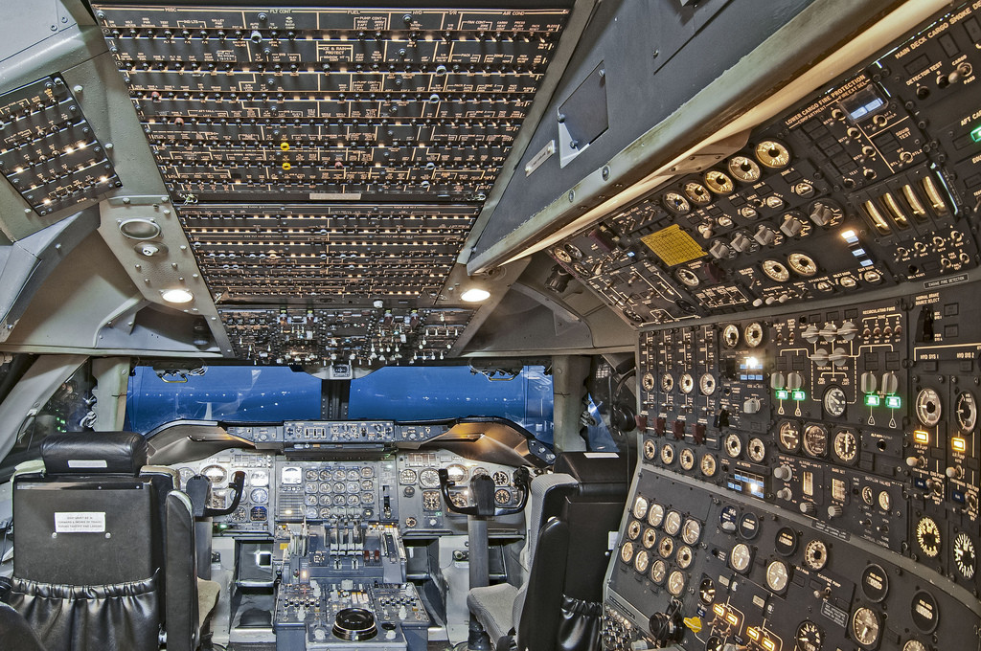
Concorde‘s cockpit

Slide 14
The 7 most useful Inkscape functions
Create objects (e.g. lines, paths, rectangles, circles)
Modify objects (e.g. scale, rotate, flip, reshape)
Align and arrange objects
Format objects (e.g. colour, line style)
Resize document
Export PNG images
Convert images to vector graphics

Slide 15

The 7 most useful Inkscape functions
Create objects (e.g. lines, paths, rectangles, circles)
Modify objects (e.g. scale, rotate, flip, reshape)
Align and arrange objects
Format objects (e.g. colour, line style)
Resize document
Export PNG image
Convert images to vector graphics

Slide 16
2 examples
Figure and icon

Slide 17
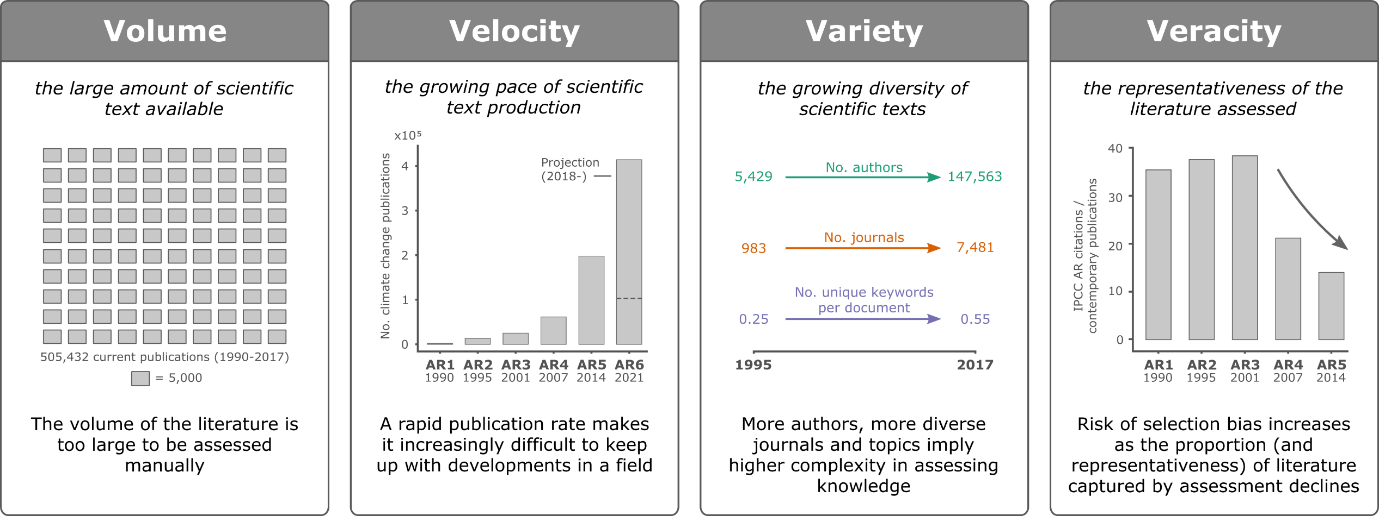
1. Create a high-quality multi-panel figure

Slide 18


2. Convert images to vector graphics

Slide 19
Resources
https://www.sciencemag.org/authors/instructions-preparing-initial-manuscript#preparation-of-figures
https://www.nature.com/nature/for-authors/formatting-guide
https://journals.plos.org/ploscompbiol/article?id=10.1371/journal.pcbi.1003833
https://inkscape.org/learn/
http://flyranch.github.io/figurefirst/
https://www.youtube.com/playlist?list=PLxtauMB7RON_2tg-mRQTuieFUr29IOKzW
www.google.com

